Slide 1
CSCI3104 Grand Project:
De-Novo Genome Assembler
Christian Simons, Connor Anthony, Johnson Cheung, Melissa Pollich

Slide 2
Presentation Overview
Summarized Solution
Overview of Algorithm Operation
General Strategy
Greedy Algorithm and Operational Metrics
Implementation Overview
Python 3, Modified String Alignment, Tail Call Optimization
Algorithm Performance
Estimated Time Complexity, Actual Runtime
Future Directions
Additional Tail Recursion, Possible Linearithmic Alignment Algorithm

Slide 3
Solution Overview:
De-Novo Sequence Assembler - Greedy Algorithm
During implementation, it was apparent that the larger the overlap of a contig, the more reliable it is as a contig.
An arbitrary metric for determining if a contig is valid or not is calculated at run-time, before any assembly.
Thus, using a greedy approach, where all possible contigs were are assembled, and the largest overlap per (i, j) pair is saved, and the rest is discarded. If the overlap is less than metric determined at run-time, then the resulting contig is not saved.
The new contigs are merged with the reads/contigs previously passed in, any instance of read ‘i’ or read ‘j’ in a contig would exclude that read from being reintegrated into a new list.
This new list of contigs and reads is recursively passed in, and the above process repeats.
The process stops when one pass of processing results in no changes to the list.

Slide 4
Solution Strategy:
Greedy Algorithm Implementation
There are two common types of implementation of a De-Novo Assembler:
Greedy Algorithm
De Brujin Graph
Greedy was chosen during prototyping, as using the algorithm based on sequence alignment was more conducive to a greedy implementation.
Since the greedy approach prioritizes overlap size, it therefore also prioritizes the reliability of contig quality.

Slide 5
Primary Phases of Assembly
01
Load genome reads from a file into a list of strings. This step parses out extra formatting strings typically included in FASTA files.
02
assemblerController() gets called, which uses contigAssembler() to create the contigs. The assemblerController() function performs all calculations and decisions.
03
Sort the final list of contigs in descending order. The list is then iterated over until the nucleotide in the middle of the entire genome is found. That contig and all previous contigs are concatenated and written to a file.

Slide 6
Program Overview
Python 3.6
Command Line
main( )
fileIO( )
Helper Functions
assemblerController( )
contigAssembler( )
determineN50( )
Write to File

Slide 7
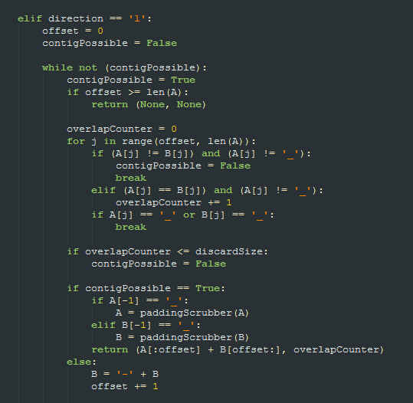
Function Overview: contigAssembler()
Sole purpose is to construct contigs.
Optimized using Tail Recursion
Inspired by string alignment
Checks both possible overlap directions
end(A) + start(B)
end(B) + start(A)

Slide 8
Function Overview: contigAssembler()
Operational Details
The controller functions makes two calls to contigAssembler() using reads A and B, two calls are performed for a ‘rightward’ and ‘leftward’ alignment.
Function operates by comparing the same indices of both strings, i.e. if A[i] == B[i].
If these two chars are not a match, a dash is prepended to either string A or B, based on the alignment direction. The function is “recursively” called with the new strings. This is done in a while loop in order to facilitate tail recursion.
The function parses through the dashes until it reaches a non-dashed character, then resumes character comparisons. The comparisons stop as soon as there is no match.
A visual representation of how the alignment occurs, produced by the console during debugging:
Str A: - - - - - - - - - - - - AATCCCCGTACATGTTGTTA
Str B: GCGCCTTGGCTAATCCCCGT
Overlap Region

Slide 9
Function Overview: contigAssembler()
Operational Details
As illustrated in the previous slide, as soon as an overlap is found, by nature of the algorithm, it is the longest overlap possible between the two sequences.

Slide 10
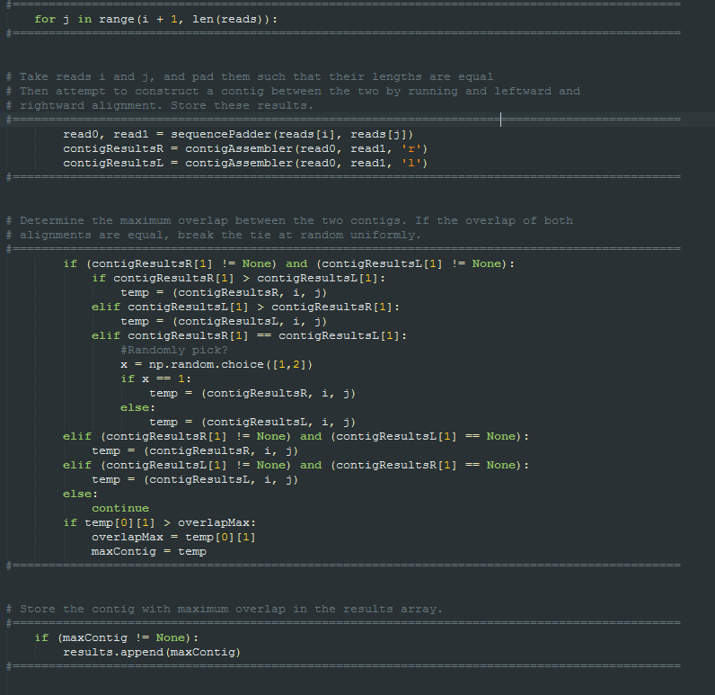
Function Overview: assemblerController()
Implements the greedy choice.
Prioritizes overlap size
Maintains uniqueness of reads in contigs

Slide 11
Function Overview: assemblerController()
Operational Details
The assemblerController function controls all the calculations being performed, aside from creating contigs themselves.
The function operates in four stages:
Assemble Contigs
Ensure Unique Read Pairs
Prune Suboptimal Contigs
Recombine

Slide 12
Function Overview: assemblerController()
Operational Details: Stage 1 - Assemble Contigs
Stage 1 utilizes a nested for loop in order to iterate over all possible contig pairs. This results in n choose 2 comparisons.
A helper function that appends underscores to create equal length strings is called on both reads before calling contigAssembler().
A leftward and rightward alignment is performed on the same (i,j) pair, and the alignment with the highest overlap value is stored.

Slide 13
Function Overview: assemblerController()
Operational Details: Stage 2 - Ensure Unique Read Pairs
Stage 2 also utilizes a nested for loop to iterate over the list of assembled contigs.
If there are any contigs that share a read with another contig, then the contig with the highest overlap value is saved.
The other contig with the lower overlap value is flagged for deletion.

Slide 14
Function Overview: assemblerController()
Operational Details: Stage 3 - Prune Suboptimal Contigs
Stage 3 uses a for loop to iterate over the same list of contigs as the previous stage.
If a contig does not contain the values ‘None’ or -1, then it is appended to a new list.
If a contig does contain said values, it is not appended to the list.

Slide 15
Function Overview: assemblerController()
Operational Details: Stage 4 - Recombine
Stage 4 iterates over the list created from stage 3, which contains only the largest overlap contigs with unique (i,j) reads.
The list of reads originally passed as a parameter is also iterated over. If any of the contigs currently saved contain a read that exists in the argument list, then that read is excluded from the final list to be either returned or passed back in recursively.
This also creates the base case for recursion. If the new list of recombined reads and contigs is the same list as the list passed in, then no processing can be done and the algorithm is finished.

Slide 16
Run-Time and Time Complexity
The typical running time for a file containing 10000 reads where read length is 500 bases long is approximately 48 hours.
There are two major sources of computation:
contigAssembler()
assemblerController()
contigAssembler() has a time-complexity of O(n^2). The only optimizations implemented involved refactoring four for loops in series into a single for loop.
The offset variable used to tracking where the prepended dashes end was re-implemented as an accumulator variable.
Recursion was removed and replaced with a while loop, effectively implementing tail call optimization.

Slide 17
Run-Time and Time Complexity
The other source of intensive computation is the assemblerController()
Tail call optimization has not been implemented yet, though it is easily transformable. No additional accumulators are needed.
Time complexity of assemblerController is more difficult to determine due to the recursive calls not having a common factor (in practice, the number of reads decreases by approximately one fifth in each call).
This would result in a recurrence relation of T((n^2)/5).
If we optimize the function to have tail recursion, the time complexity would be approximately O(n^3)
Thus, since the assemblerController function calls the contigAssembler function in each iteration, the overall time complexity is approximately O(n^5).

Slide 18
Future Directions
Increasing Optimizations - Tail Recursion, Dynamic Programming
Convert the assemblerController function to be tail recursive.
Since each contig will most likely be overlapped with another contig, a subproblem exists such that solving it leads to another subproblem. Solving these subproblems eventually will lead to a solution.
With this property known, and with more time, a dynamic programming approach could be used to optimize the algorithm even further.

Slide 19
Future Directions
Increasing Optimizations - Potential Linearithmic Alignment
An unfinished optimization of the contigAssembler function could run in O(nlogn) time.
Currently it is not finished, as opposed to using a nested for loop, the algorithm uses a single while loop, and two indices that point to specific locations in each string during alignment.
Since one index can decrement during alignment, it cannot be done in linear time. However, if properly implemented, the worst case would be quadratic, on average would be linearithmic, and best case could be linear.

Slide 20
Thank You!

